Slide 1
Class 5
BUS 696
Prof. Jonathan Hersh

Slide 2
BUS 696: Class 5 Announcements
Pset 3 solutions
Problem Set 4 Posted
Questions?

Slide 3
BUS 696: Class 5 Outline
AI in the News
Classification Intro
Why not Linear Models?
Sigmoid/Logistic Model
Odds Ratio
Estimating logit model using glm()
Generating predicted probabilities
Choosing probability cutoffs
Confusion matrices
More Diagnostics

Slide 4
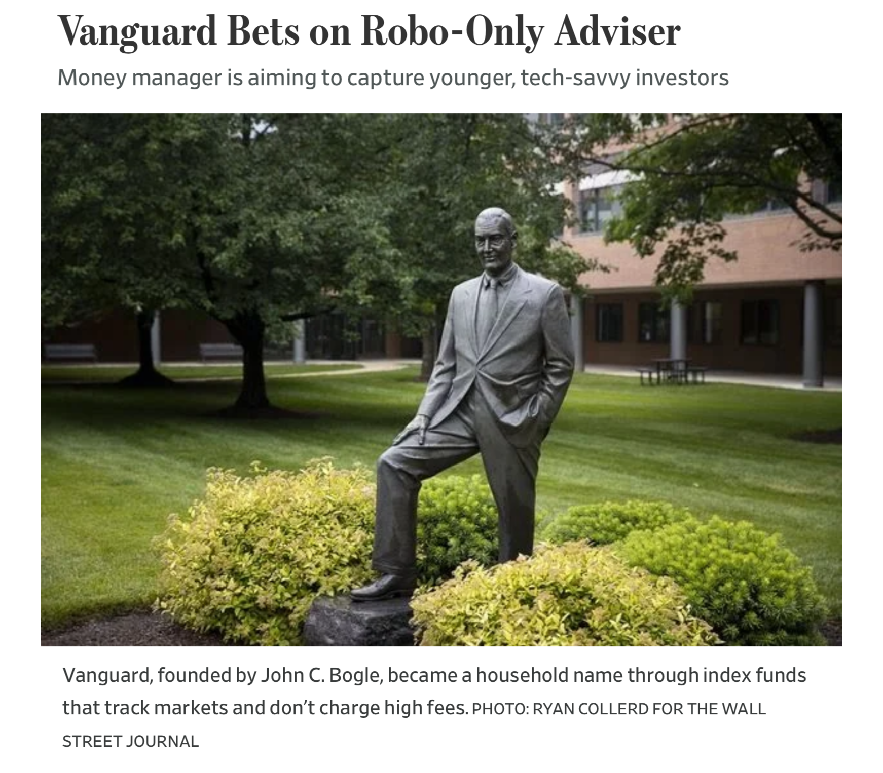
AI in the News

Slide 5
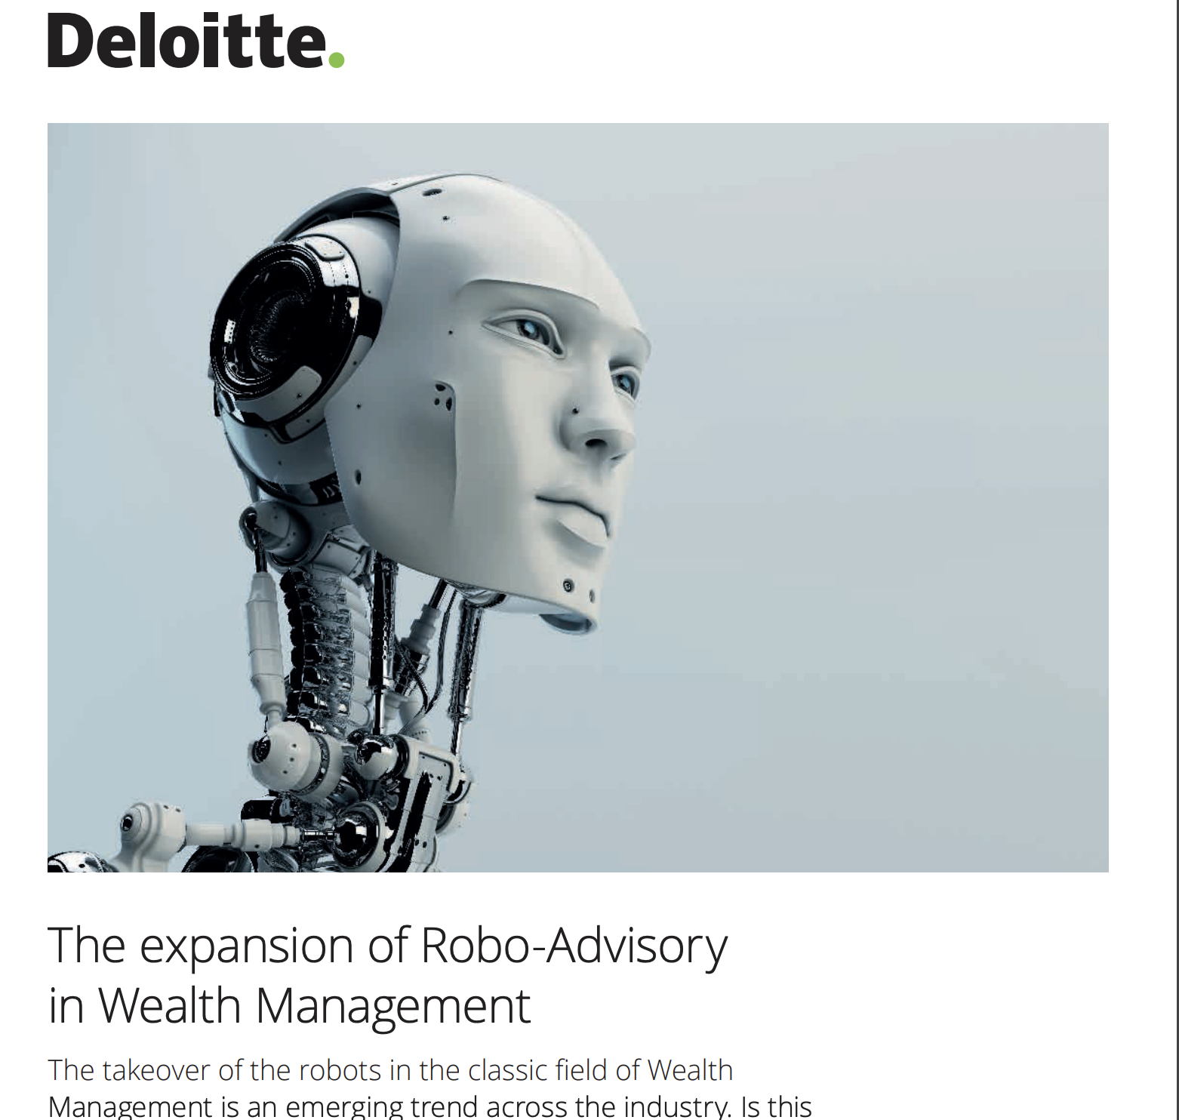
Robo-Advisers Background

Slide 6
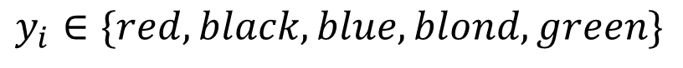
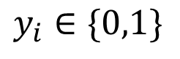
What is classification?
Regression problem: identifying to which discrete class a particular observation belongs.
$$y_{i}∈\{0,1\}$$
$$y_{i}∈\{red,black,blue,blond, green\}$$

Slide 7



Classification examples

Slide 8
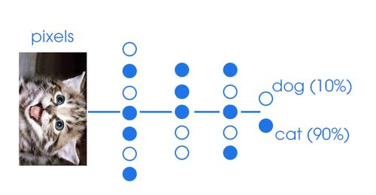


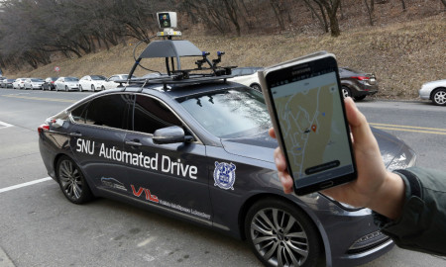
More classification examples

Slide 9
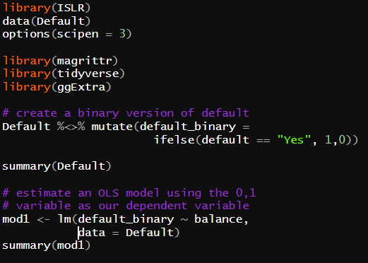
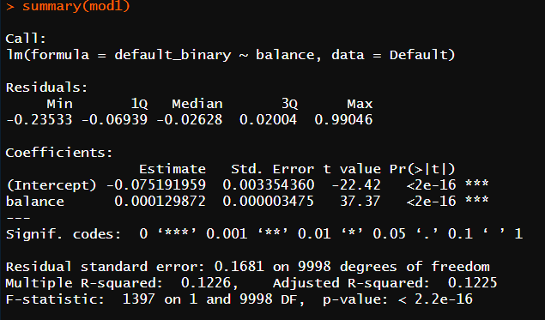
Why not regression?

Slide 10
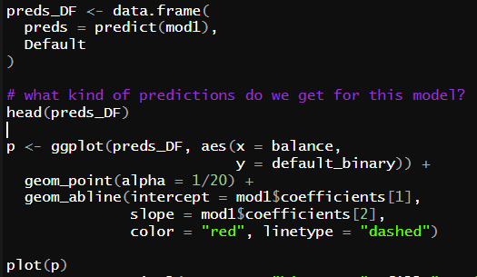
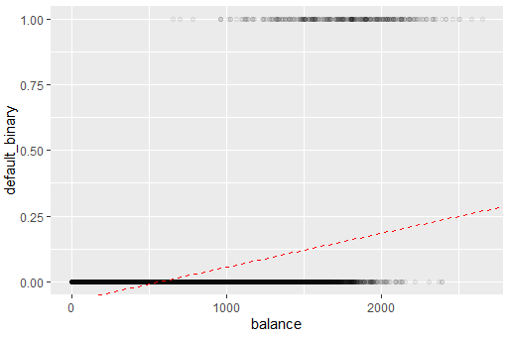
Why not regression?

Slide 11
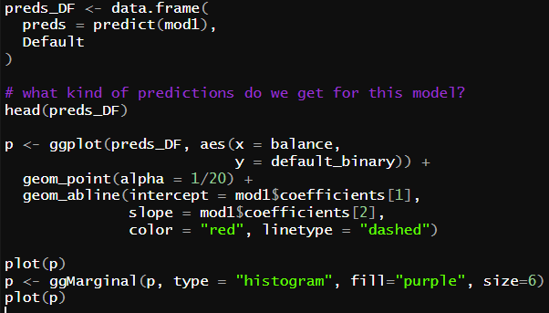
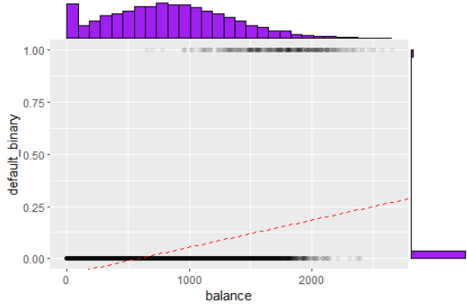
Why not regression?

Slide 12
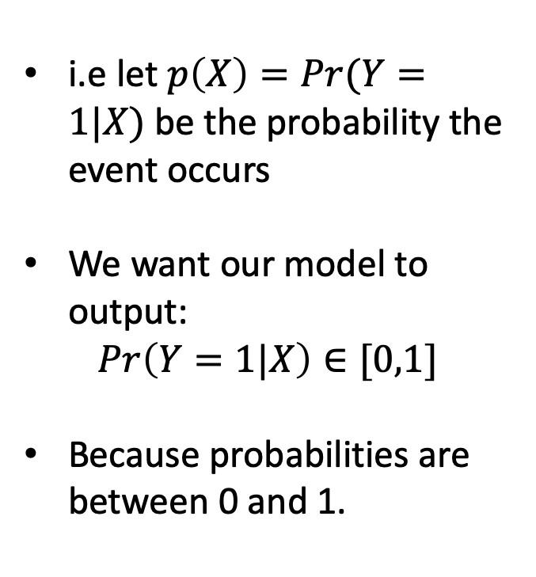
What We Want Ideally:
i.e let $p\left(X\right)=Pr(Y=1|X)$ be the probability the event occurs
We want our model to output:
$$Pr\left(Y=1|X\right)∈[0,1]$$
Because probabilities are between 0 and 1.

Slide 13
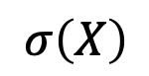
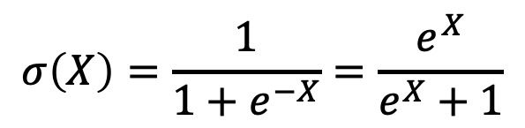
Logistic/Sigmoid Function
Function that naturally takes inputs X and transforms between 0 and 1
1
$$σ\left(X\right)=\frac{1}{1+e^{−X}}=\frac{e^{X}}{e^{X}+1}$$
$$σ\left(X\right)$$
0
X

Slide 14
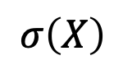
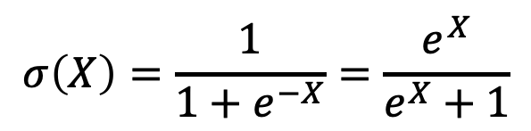
Logistic/Sigmoid Function
Function that naturally takes inputs X and transforms between 0 and 1
1
$$σ\left(X\right)$$
0.5
$$σ\left(X\right)=\frac{1}{1+e^{−X}}=\frac{e^{X}}{e^{X}+1}$$
0
0
100
200
X

Slide 15
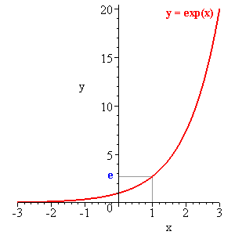

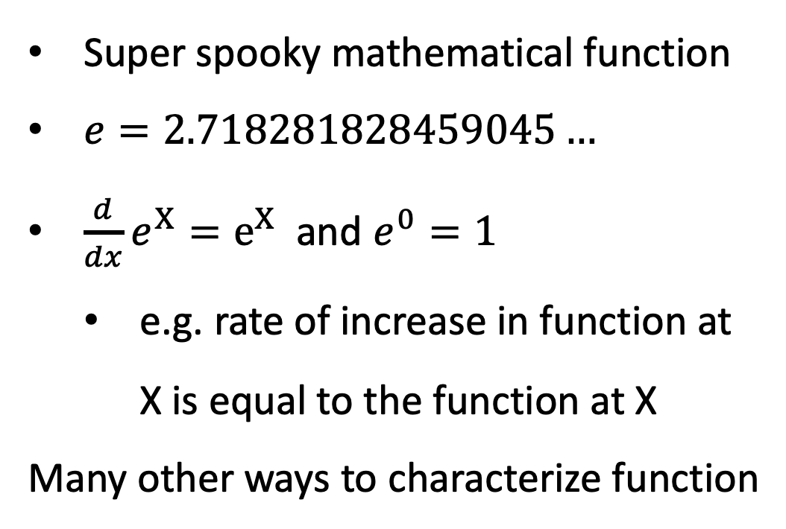
A note on $e^{X}=exp⁡(X)$
Super spooky mathematical function
$e=2.718281828459045…$
${\frac{d}{dx}e}^{X}=e^{X}$ and $e^{0}=1$
e.g. rate of increase in function at X is equal to the function at X
Many other ways to characterize function

Slide 16
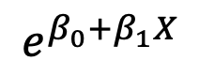
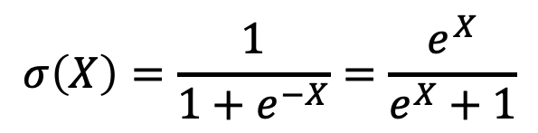
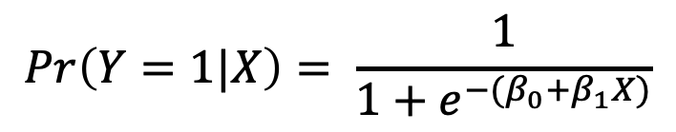
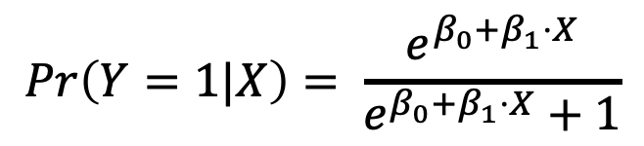
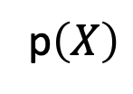
Logistic/Sigmoid Function to Probabilities
$$σ\left(X\right)=\frac{1}{1+e^{−X}}=\frac{e^{X}}{e^{X}+1}$$
1
p$\left(X\right)$
0.5
$$Pr\left(Y=1|X\right)= \frac{e^{β_{0}+β_{1}⋅X}}{e^{β_{0}+β_{1}⋅X}+1}$$
$$Pr\left(Y=1|X\right)= \frac{1}{{1+e}^{{−(β}_{0}+β_{1}X)}}$$
0
0
100
200
$$e^{β_{0}+β_{1}X}$$

Slide 17
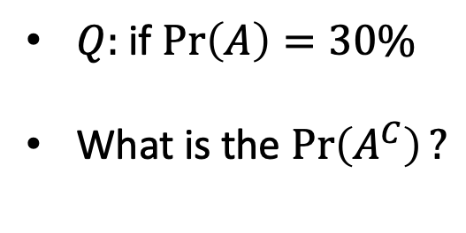
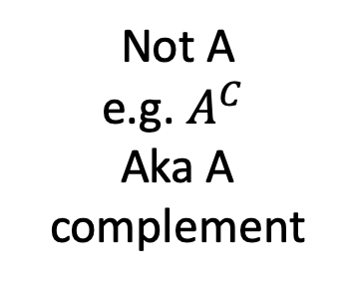
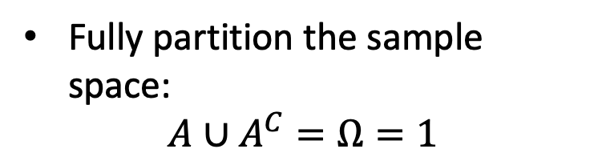
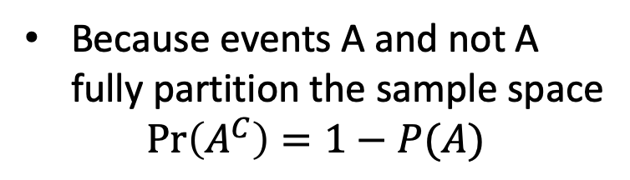
Probability Note on The Complement
Sample Space (All possible outcomes)
$Q:$ if $\operatorname{Pr}\left(A\right)=30\%$
What is the $\operatorname{Pr}\left(A^{C}\right)?$
Not A
e.g. $A^{C}$
Aka A complement
Event A
Because events A and not A fully partition the sample space
$$\operatorname{Pr}\left(A^{C}\right)=1−P(A)$$
Fully partition the sample space:
$$A∪A^{C}=Ω=1$$

Slide 18

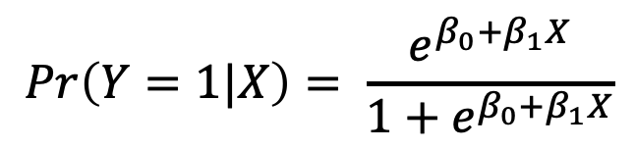
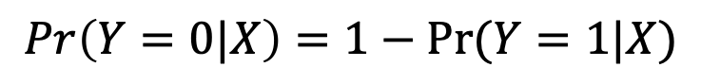
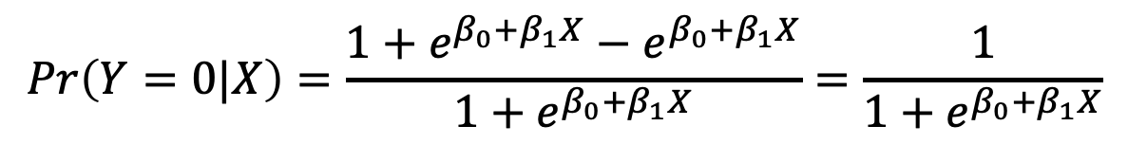
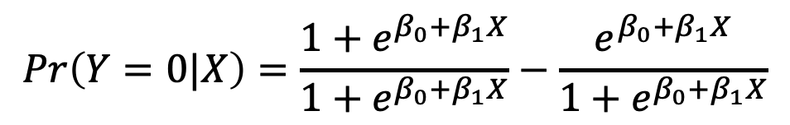
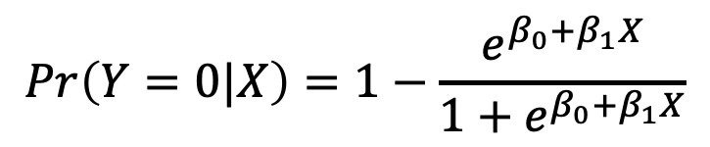
One Weird Trick to Find P(Y=0)
$$Pr\left(Y=1|X\right)= \frac{e^{β_{0}+β_{1}X}}{{1+e}^{β_{0}+β_{1}X}}$$
$$Pr\left(Y=0|X\right)=1−\operatorname{Pr}{(Y=1|X)}$$
$$Pr\left(Y=0|X\right)=1−\frac{e^{β_{0}+β_{1}X}}{{1+e}^{β_{0}+β_{1}X}}$$
$$Pr\left(Y=0|X\right)=\frac{{1+e}^{β_{0}+β_{1}X}}{{1+e}^{β_{0}+β_{1}X}}−\frac{e^{β_{0}+β_{1}X}}{{1+e}^{β_{0}+β_{1}X}}$$
$$Pr\left(Y=0|X\right)=\frac{{1+e}^{β_{0}+β_{1}X}−e^{β_{0}+β_{1}X}}{{1+e}^{β_{0}+β_{1}X}}=\frac{1}{{1+e}^{β_{0}+β_{1}X}}$$

Slide 19
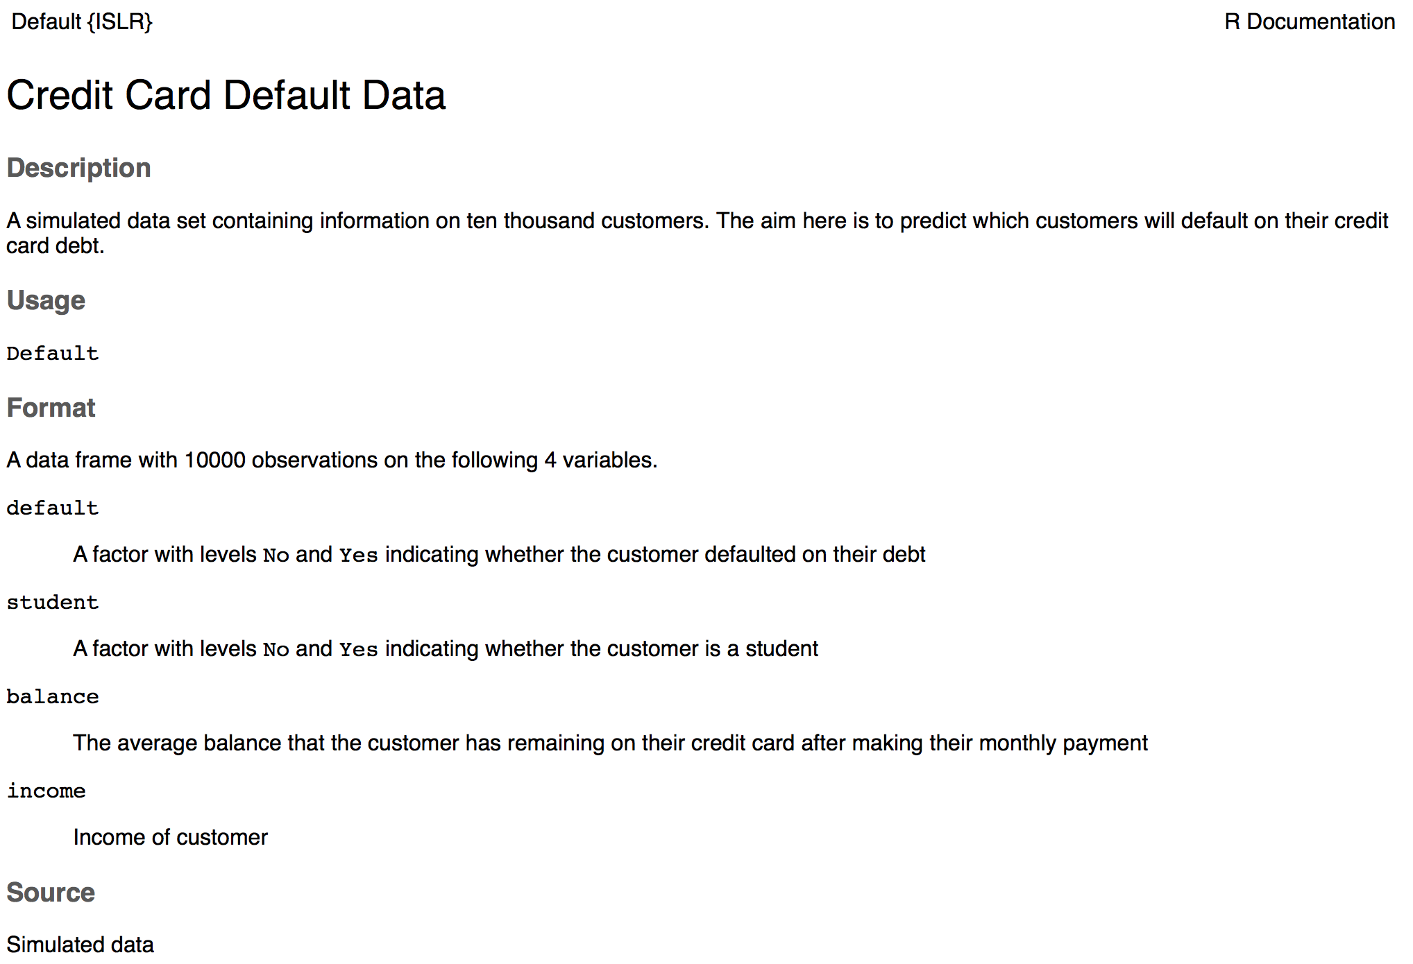
Credit Card Default Dataset

Slide 20
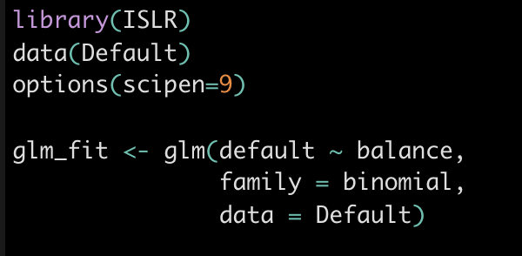
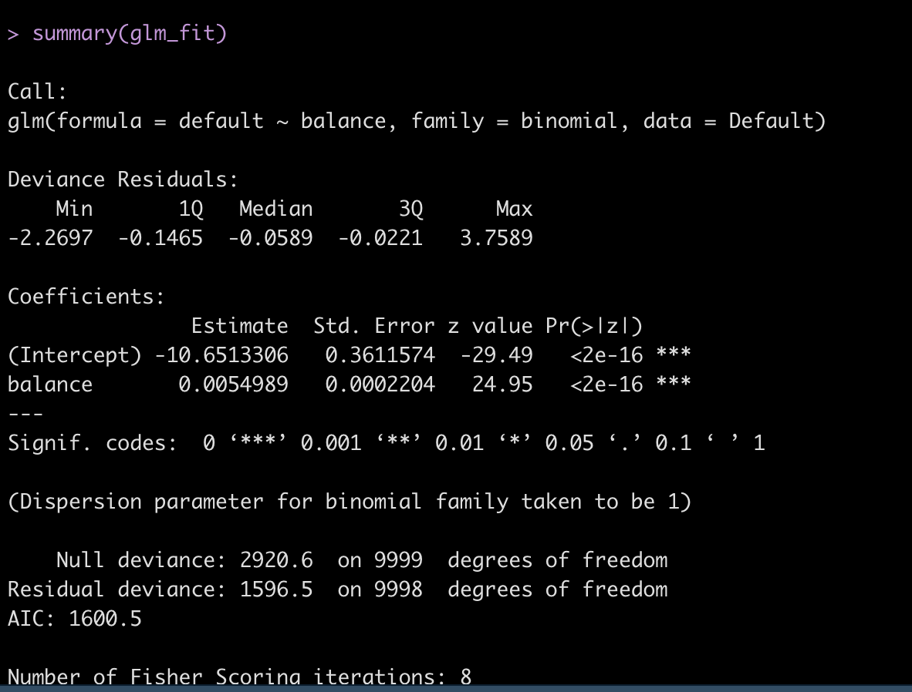
Estimate Logit Model Using glm()

Slide 21
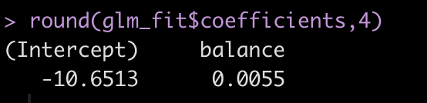
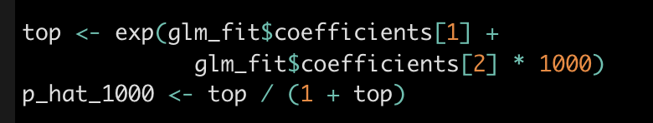
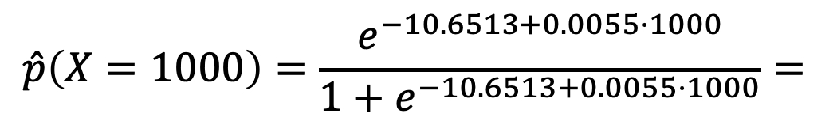
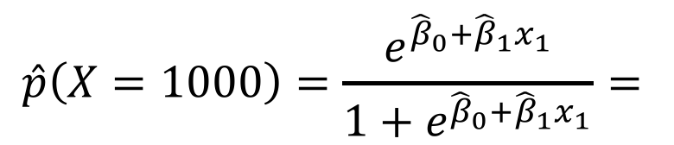
Making Predictions From Estimated Logit model
$$\hat{p}\left(X=1000\right)=\frac{e^{{\hat{β}}_{0}+{\hat{β}}_{1}x_{1}}}{1+e^{{\hat{β}}_{0}+{\hat{β}}_{1}x_{1}}}=$$
$$\hat{p}\left(X=1000\right)=\frac{e^{−10.6513+0.0055⋅1000}}{1+e^{−10.6513+0.0055⋅1000}}=$$

Slide 22
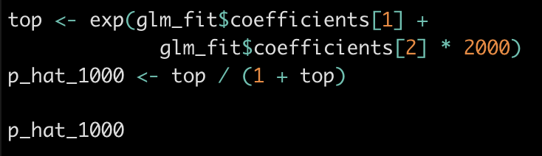
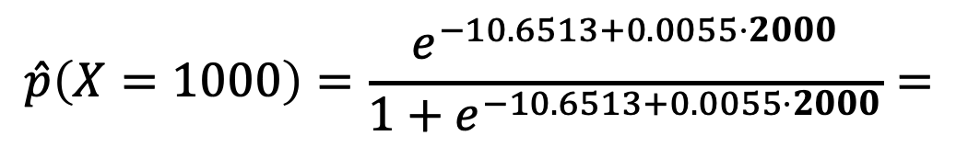
Making Predictions From Estimated Logit Model Balance == $2000
$$\hat{p}\left(X=1000\right)=\frac{e^{{\hat{β}}_{0}+{\hat{β}}_{1}x_{1}}}{1+e^{{\hat{β}}_{0}+{\hat{β}}_{1}x_{1}}}=$$
$$\hat{p}\left(X=1000\right)=\frac{e^{−10.6513+0.0055⋅2000}}{1+e^{−10.6513+0.0055⋅2000}}=$$

Slide 23
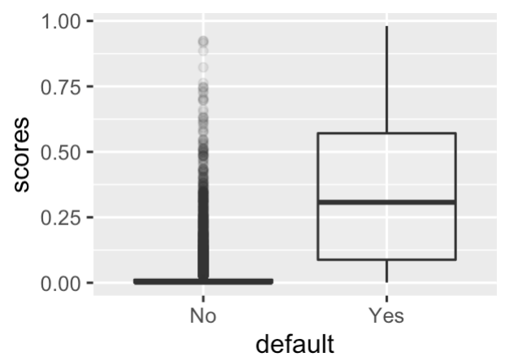
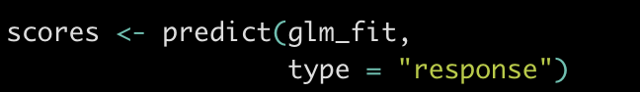
Generating Predicted Probabilities For All Observations in Our Dataset
We say we “score” the model when we assign predicted probabilities for each observation in our datasetd
Note type = “response”! Otherwise what happens?

Slide 24
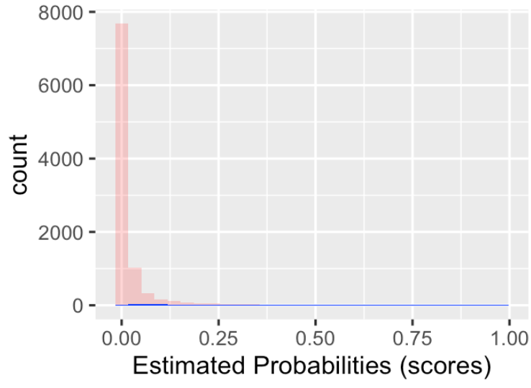
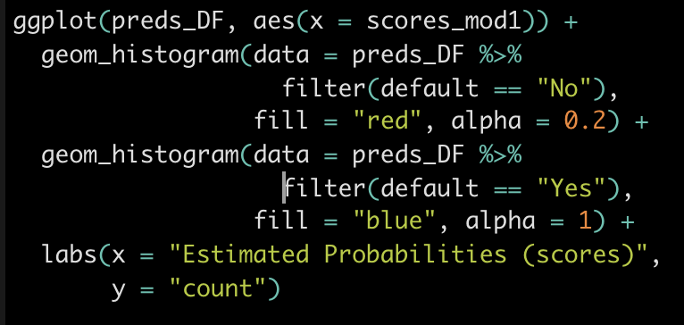
Histogram of Scores by Default Status

Slide 25
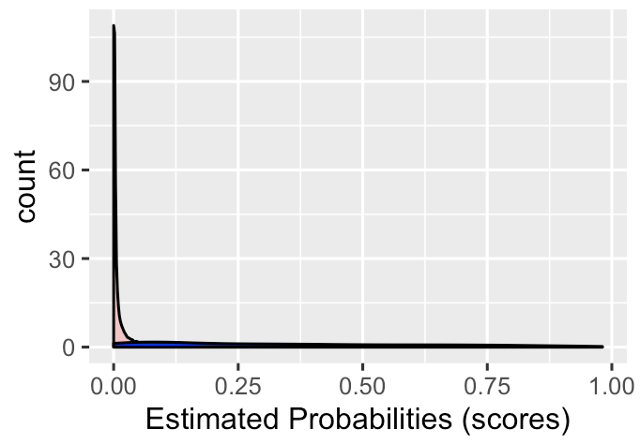
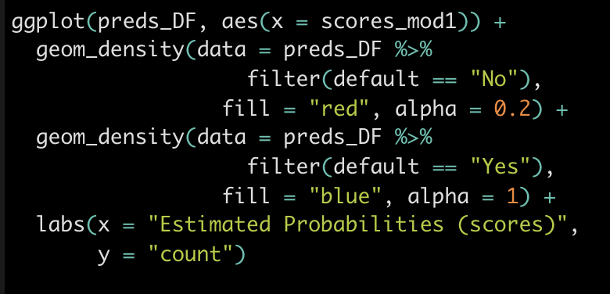
Density of Scores by Default Status

Slide 26
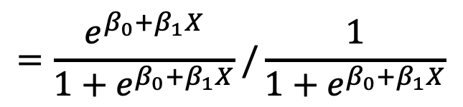
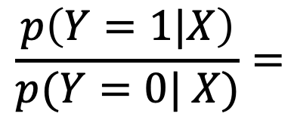


Expressing Ratio of Probabilities: Odds Ratio
Armed with P(Y=1) and P(Y=0) we know probabilities for each of these events
A useful expression is the odds ratio, or the ratio of events occurring
$$\frac{p\left(Y=1|X\right)}{p(Y=0| X)}=$$
$$=\frac{e^{β_{0}+β_{1}X}}{{1+e}^{β_{0}+β_{1}X}}/\frac{1}{{1+e}^{β_{0}+β_{1}X}}$$
$$=\frac{e^{β_{0}+β_{1}X}}{{1+e}^{β_{0}+β_{1}X}}⋅\frac{{1+e}^{β_{0}+β_{1}X}}{1}$$
$$=e^{β_{0}+β_{1}X}$$

Slide 27



Example odds ratio: pr(Y = “rain” | X)
$$\frac{p\left(Y=rain|X\right)}{1−p(Y=rain|X)}=$$
$$=\frac{0.2}{0.8}=\frac{1}{4}$$

Slide 28



Example odds ratio: pr(“Dems win house”|X)
$$\frac{p\left(Y=“Dems win”|X\right)}{1−p(Y=“Dems win”|X)}=$$
$$=\frac{0.8}{0.2}=4$$

Slide 29



Log Odds Ratio
$\frac{p\left(Y=1|X\right)}{p(Y=0| X)}=$ $e^{β_{0}+β_{1}X}$
$log\left(\frac{p\left(Y=1|X\right)}{p(Y=0| X)}\right)=$ $log\left(e^{β_{0}+β_{1}X}\right)$
Log odds ratio is a linear expression of constants and coefficients!
$$log\left(\frac{p\left(Y=1|X\right)}{p(Y=0| X)}\right)=β_{0}+β_{1}X$$

Slide 30


From probabilities to classes?

Slide 31

Adding More Variables
Interpret coefficients as impact on log odds!

Slide 32

Student as “confounder”

Slide 33

Plotting Model Probabilities Against Balance by Default Status

Slide 34
“Confusion” Matrix
 |  | True default status
 |  | No | Yes
Predicted default status | No | True negative (TN) | False Negative (FN)
 | Yes | False Positive (FP) | True Positive (TP)

Slide 35

Assigning Class=Default to $\hat{p}>0.5$

Slide 36

Assigning Class=Default to $\hat{p}>0.5$
preds_sample

Slide 37

Assigning Class=Default to $\hat{p}>0.5$

Slide 38
Choosing Probability Cutoff to Assign Class
True
Default = 0
True Default = 1
Model Probabilities

Slide 39
Threshold A: Moderate Threshold
Threshold A
True
Not Default
True Default
False
Negatives
False
Positives
-
+
Model Probabilities

Slide 40
Threshold B: Higher Threshold
Threshold B
True
Not Default
True Default
False
Negatives
Model Probabilities
False
Positives

Slide 41
Comparing cutoffs:
Threshold A
True
Not Default
True Default
Many false positives
-
+
Threshold B
True
Not Default
True Default
Few false positives
Model Probabilities

Slide 42
Which Probability Cutoff To Use?
Threshold A
Threshold you choose should depend on relative costs of FPs and FN
e.g. screening at airport (cost of False neg high)
(e.g.
Some common choices
Maximize Accuracy (equal weighting of FPs and FNs)
Threshold p_hat > 0.5
True
Not Default
True Default
-
+
Threshold B
True
Not Default
True Default
Model Probabilities

Slide 43

Threshold choice affects TP and TNs

Slide 44

Accuracy and mis-classification rate
 |  | True default status
 |  | No | Yes
Predicted default status | No | TN = 9,627 | FN = 228 | $N^{∗}$ = 9855
 | Yes | FP = 40 | TP = 105 | $P^{∗}$= 145
 |  | N = 9,667 | P = 333
Accuracy “How often is my classifier correct?”
(TP+TN)/Total = (9,627 + 105) / 10,000 = 97.3%
Mis-classification rate “How often is the classifier wrong?”
(FP + FN)/Total = (40 + 228) / 10,000 = 2.68%
No Information Rate “Everyone is the majority class”
(FP + FN)/Total = (40 + 228) / 10,000 = 2.68%

Slide 45
Sensitivity and Specificity
 |  | True default status
 |  | No | Yes
Predicted default status | No | TN = 9,627 | FN = 228 | $N^{∗}$ = 9855
 | Yes | FP = 40 | TP = 105 | $P^{∗}$= 145
 |  | N = 9,667 | P = 333
Sensitivity: True positive rate (aka 1 – power or recall)
TP/P = 105 / 333 = 31.5%
Specificity: True negative rate
TN/N = 9627 / 9667= 99.5%
False positive rate (aka Type I error, 1 - Specificity)
FP/N =

Slide 46
Confusion Matrices in R

Slide 47

F1 and Kappa Statistic
 |  | True default status
 |  | No | Yes
Predicted default status | No | TN = 9,627 | FN = 228 | $N^{∗}$ = 9855
 | Yes | FP = 40 | TP = 105 | $P^{∗}$= 145
 |  | N = 9,667 | P = 333
F1 score
Harmonic mean of precision and recall
$F1=2\frac{precision ∗ recall}{precision + recall}$
Kappa statistic:
Takes into account accuracy that would have been generated by random chance
Kappa $\frac{O−E}{1−E}=\frac{observed accuracy−expected accuracy}{1−expected accuracy}$
Higher kappa – better than random chance

Slide 48

Sensitivity and Specificity

Slide 49


Slide 50
AUC = Area Under Curve
AUC = Area Under Curve

Slide 51

Calibration plot

Slide 52
Lift Chart
To construct a lift chart, use any method to get predicted probabilities
Then order observations by probabilities
For each predicted, probability, count whether event actually occurred

Slide 53

Lift Chart

Slide 54

Lift Chart

Slide 55

Severe class imbalance

Slide 56

Remedy 1: alternate score cutoff

Slide 57
Remedy 1: alternate score cutoff

Slide 58

Remedies 2,3&4 under-sample majority class, oversample minority class, SMOTE interpolate minority class

Slide 59

Remedy 5: Use calibration plot to change model

